Slide 1
HerDoc Backend
Kubernetes deployment and monitoring

Slide 2
Agenda
1
Deployment overview
2
Tech stack
3
Architecture
4
Configuration
5
Verification
6
Monitoring and next steps

Slide 3
Deployment at a glance
2/2
1/1
100%
8000
Pods ready
DB migration job complete
Prometheus scrape availability
Service port (ClusterIP)

Slide 4
Tech stack
Backend
Containers
Orchestration
Python
Docker
Kubernetes
API served by Uvicorn
Image herdoc-backend:latest
Deployment, Service and migration Job
Automation
Metrics
Dashboards
Ansible
Prometheus
Grafana
Automation tooling
Scrapes /metrics from the backend
HERDOC API Overview

Slide 5
Ansible: key concepts
Open-source automation tool for configuration management and deployment
Agentless
Playbooks
Inventory
Connects over SSH; nothing to install on targets
YAML files describing the steps to run
List of hosts and groups to manage
Modules
Idempotent
Roles
Units of work, such as installing a package
Re-running changes nothing if already correct
Reusable bundles of tasks and variables

Slide 6
How the pieces connect
DB migrate
Backend
Service
Prometheus
Grafana
Job
Deployment
ClusterIP
Metrics
Dashboard
Complete, 10s
2 replicas
10.96.3.18:8000
job herdoc-backend
HERDOC API Overview

Slide 7
Deployment configuration
Rollout
Resources
RollingUpdate strategy
0 max unavailable
1 max surge
Requests: 100m CPU, 256Mi
Limits: 1 CPU, 1Gi
Image: herdoc-backend:latest
Probes
Configuration
Liveness and readiness on /health
Liveness: 15s delay, 20s period
Readiness: 5s delay, 10s period
ConfigMap: herdoc-backend-config
Secret: herdoc-backend-secrets
Both loaded via envFrom

Slide 8
Health and metrics endpoints
200
/health
200
/metrics
Returns {"status":"ok"}
Content-Type: application/json
Used by liveness and readiness probes
Prometheus text format, 4351 bytes
Content-Type: text/plain; version=0.0.4
Scraped by Prometheus
Checked locally on port 8001; both return 200 OK from uvicorn

Slide 9
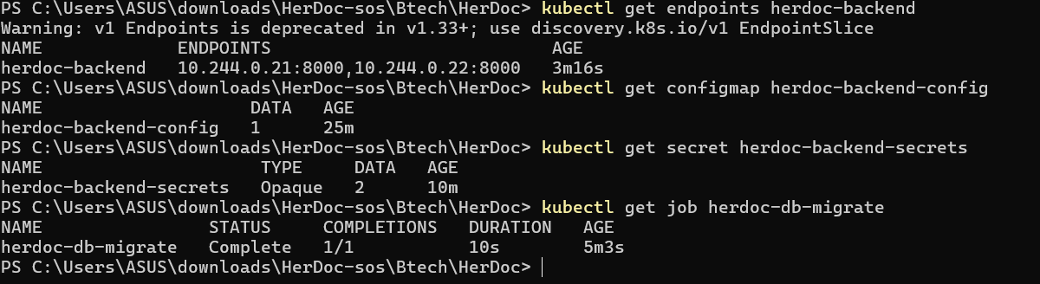
Resources verified
Endpoints
Config
Migration
2 pod IPs on port 8000
ConfigMap and Secret present
Job complete, 1/1 in 10s

Slide 10
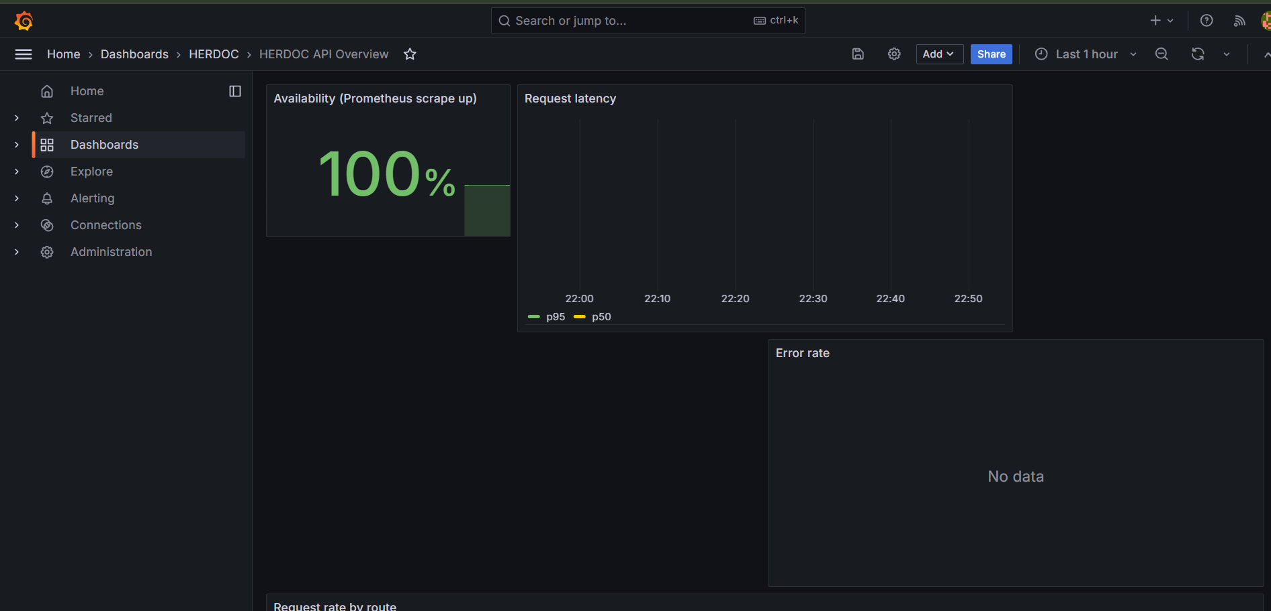
Grafana dashboard
Availability panel reads 100%
Latency and error rate panels have no data yet
/health and /metrics both return 200 OK locally

Slide 11
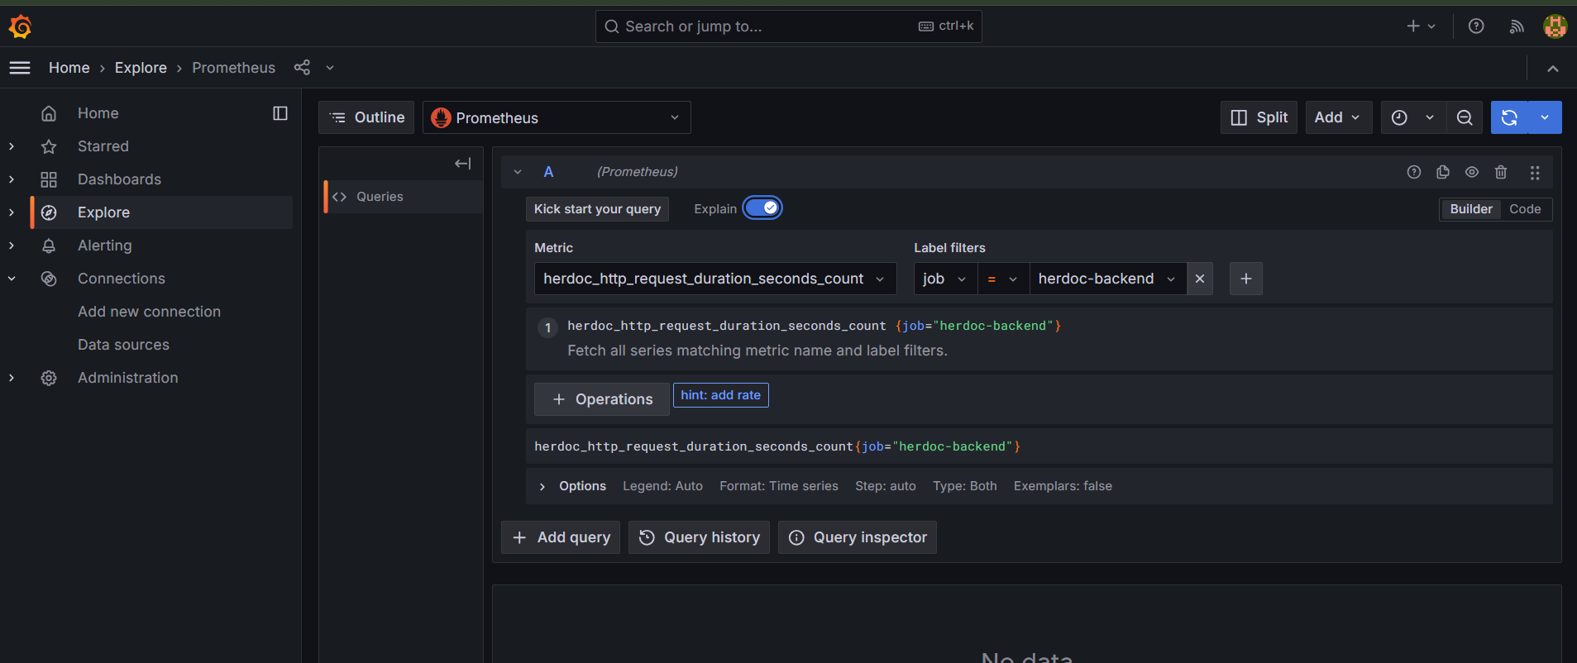
Open item: no request data
Next steps
Send requests to the API and refresh
Check the duration metric appears at /metrics
Confirm panel queries use job herdoc-backend

Slide 12
Status summary
Backend deployment
2/2 pods available
DB migration job
Complete in 10s
Health endpoint
200 OK
Prometheus scrape
100% up

